Slide 1
Managing Kernel Modules
Explore the Linux Kernel
Install and Configure Kernel Modules
Monitor Kernel Modules

Slide 2

Topic A: Explore the Linux Kernel
Exam Objectives:
This topic does not cover specific exam syllabus objectives or content examples.

Slide 3
Kernel (Slide 1 of 2)
The core component of an operating system.
All other components rely on it.
Manages file system access, memory, processes, devices, etc.
Controls all plugged-in hardware devices.
One of first elements to be loaded on startup.
Remains in memory during computer's operation.
Contains system-level commands/functions hidden from users.

Slide 4
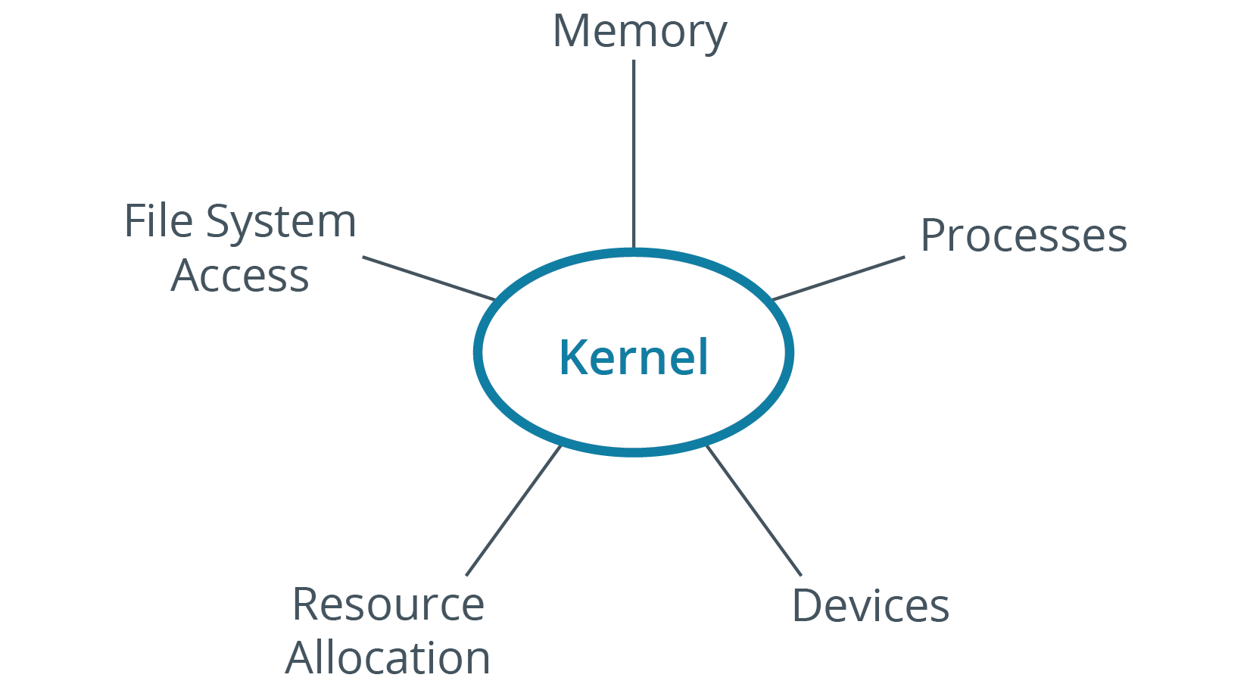
Kernel (Slide 2 of 2)

Slide 5
Kernel Space and User Space (Slide 1 of 2)
Kernel space:
Region in memory where kernel executes its services.
User space:
Region in memory outside of kernel space.
Includes high-level apps, background processes, system libraries, etc.
Software in user space accesses kernel space services.
Issues system calls.
Provides app with resources needed to perform a task.
Example: App calls kernel to leverage I/O for data storage writing.
Split between spaces promotes stability and security.

Slide 6
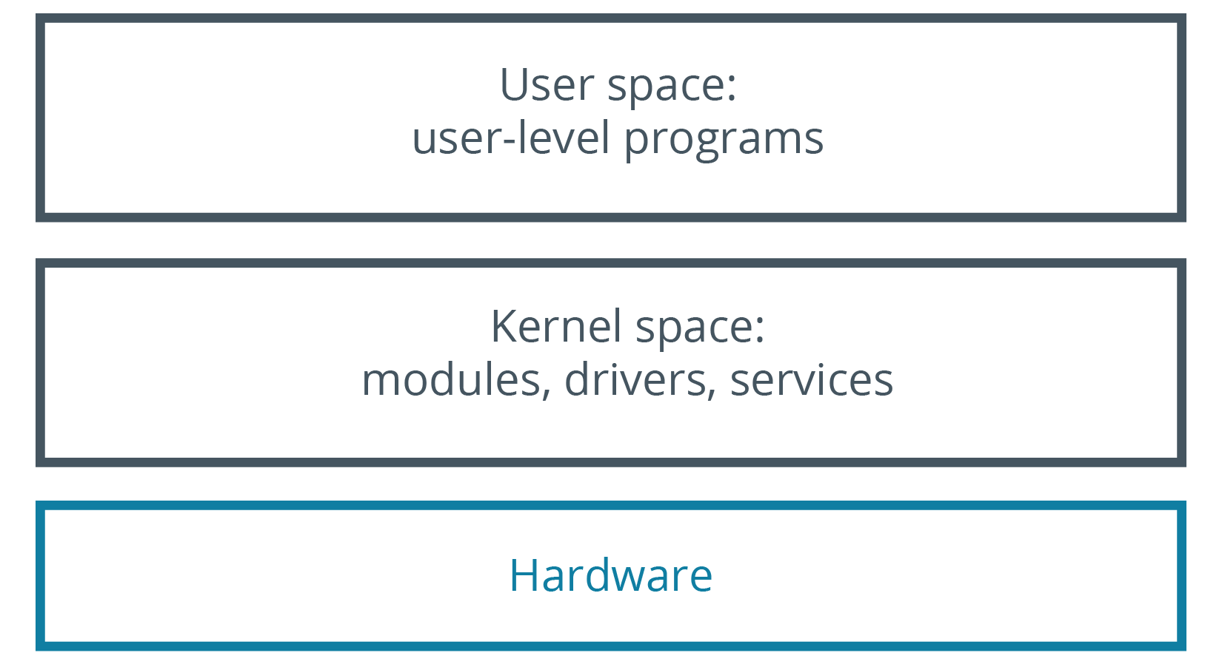
Kernel Space and User Space (Slide 2 of 2)

Slide 7
Types of Kernels
Monolithic:
All system modules run in kernel space.
Can interact quickly with devices.
Large size, consumes more RAM.
Less stable.
Microkernel:
Runs minimum resources necessary.
Smaller kernel space, larger user space.
Smaller over size, consumes less RAM.
More stable.
Worse performance.
Notes:
Teaching Tip: Drivers are discussed more in the lesson on managing devices.

Slide 8
The Linux Kernel
A free and open source monolithic kernel that manages all other resources on the operating system.
Device drivers run within kernel space.
Have full access to hardware.
Architecture provides many useful features.
Virtual memory, TCP/IP networking, shared libraries, etc.
Kernel is modular.
Users can configure/extend kernel functionality.
Each update is given a version number.
Format: major.minor
4.19 released in 10/2018.

Slide 9

Kernel Versioning

Slide 10
The uname Command (Slide 1 of 2)
Prints name of kernel.
uname -r prints kernel version.
uname -i prints hardware platform.
uname -a prints all.

Slide 11
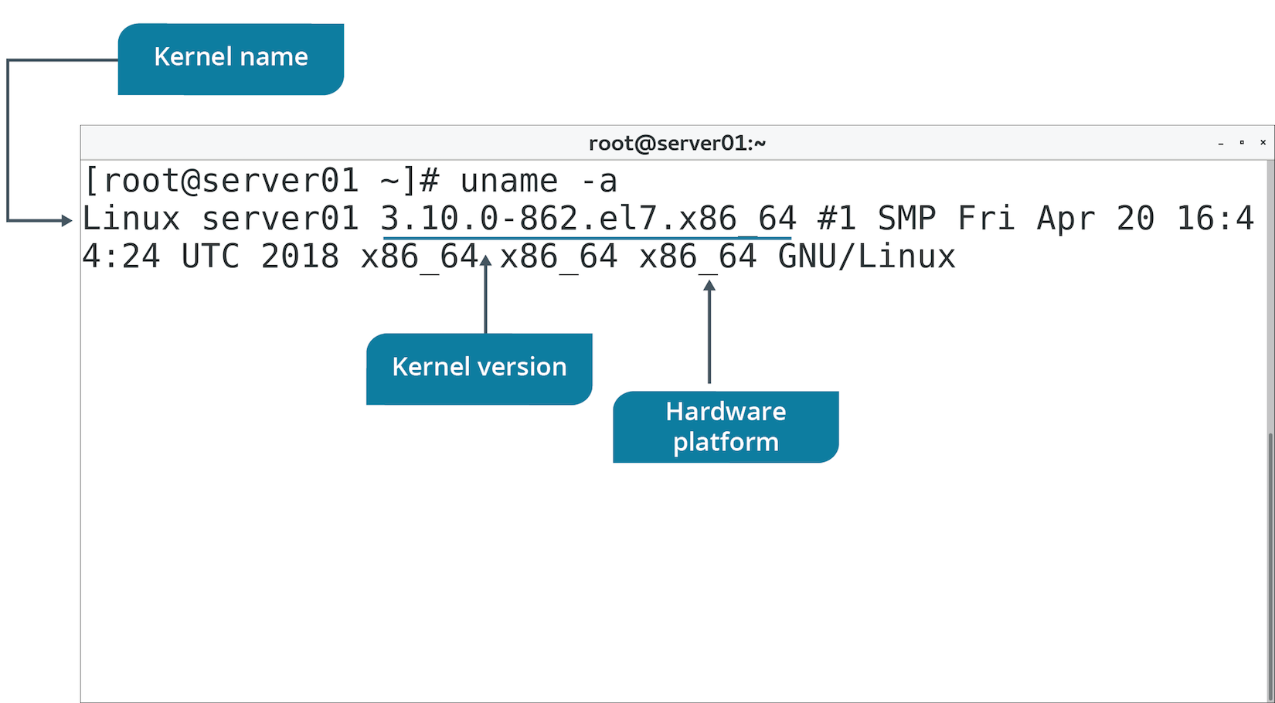
The uname Command (Slide 2 of 2)

Slide 12
Kernel Layers
Kernel Layer | Function
SCI | Handles system calls sent from user space to kernel. Enables scheduling of calls and of managing multiple calls at once.
Process management | Allocates execution space on processor to processes. Shares processor time for multiple processes.
Memory management | Shares memory with user space resources. Allocates memory on request and frees it when no longer needed.
File system management | Stores, organizes, and tracks files. Also supports VFS.
Device management | Manages interface between devices and user space. Reads calls to devices and passes them on.

Slide 13
Discussing the Linux Kernel

Slide 14
Activity 6-1: Discussing the Linux Kernel
In the monolithic kernel vs. microkernel debate, Linus Torvalds chose a monolithic kernel for Linux. Why?
ANSWER:
Although a monolithic kernel is larger than its microkernel counterpart, the tradeoffs for running system modules, device drivers, and file systems in kernel space, and overall speed, far outweigh the main disadvantage of size.

Slide 15
Activity 6-1: Discussing the Linux Kernel
As an administrator, it is one of your jobs to keep track of the kernel versions on your Linux systems and attempt to be consistent where possible. Which command can you run to see the kernel version?
ANSWER:
uname -r returns the kernel's major and minor version numbers, making it easier to compare versions across many systems.

Slide 16
Activity 6-1: Discussing the Linux Kernel
One of the most important qualities of the Linux kernel is that it is modular. What does this feature do for Linux as a whole?
ANSWER:
Modularity enables users to configure and extend the kernel's functionality to meet specific needs.

Slide 17
Activity 6-1: Discussing the Linux Kernel
How does the Linux kernel handle memory management for applications?
ANSWER:
The kernel maps or allocates the available memory to applications or programs on request and frees the memory automatically when the execution of the programs is complete. This ensures that memory can be allocated to other programs.

Slide 18
Activity 6-1: Discussing the Linux Kernel
How does the Linux kernel handle memory management for applications?
ANSWER:
The kernel maps or allocates the available memory to applications or programs on request and frees the memory automatically when the execution of the programs is complete. This ensures that memory can be allocated to other programs.

Slide 19
Activity: Exploring the Linux Kernel
You may need to troubleshoot kernel issues.
You'll explore kernel concepts to refresh your knowledge.

Slide 20
Topic B: Install and Configure Kernel Modules
Exam Objectives:
1.2 Given a scenario, install, configure, and monitor kernel modules.
1.3 Given a scenario, configure and verify network connection parameters. 4.1 Given a scenario, analyze system properties and remediate accordingly.

Slide 21
Kernel Modules
System-level objects that extend the functionality of the kernel.
Can be dynamically loaded/unloaded.
Kernel can recompile itself with a reboot.
Advantages:
Reduce burden on kernel.
Dynamic loading reduces memory consumption.
Avoid reboot when new functionality is required.
Use .ko extension.
Module for one kernel version may not be compatible with other versions.

Slide 22
The /usr/lib/ Directory
Contains shared libraries and binaries for software packages.
Not meant to be executed by users.
/usr/lib/modules contains modules for different kernel versions.
Has directory named after kernel's version number.
Modules are in subdirectories based on category.
Example Bluetooth driver module location:
/usr/lib/modules/<kernel version>/kernel/drivers/bluetooth/

Slide 23
Kernel Module Management Commands
Command | Used To
lsmod | Display loaded kernel modules and their details.
modinfo | Display info about a particular module.
insmod | Install module into running kernel. Doesn't install dependencies.
rmmod | Remove module from running kernel.
Notes:
Teaching Tip: Consider pointing out that these commands can be used with grep for more efficient analysis.

Slide 24
The modprobe Command
Used to add/remove modules from kernel.
Can load dependent modules as well.
Preferred over insmod and rmmod commands.
Use -a option to add modules.
Use -r option to remove modules.

Slide 25
The depmod Command
modprobe reads modules.dep to identify dependencies.
Needs this to be accurate.
depmod command updates modules.dep database.
Searches contents of /lib/modules/<kernel version>/ for each module.
Modules may export "symbols" (services).
Other modules may use exported symbols.
depmod aggregates instances of symbol export/use.
Builds modules.dep this way.

Slide 26
Kernel Module Configuration (Slide 1 of 2)
/etc/modprobe.conf
Configuration file whose settings apply to loaded modules persistently.
Can configure module dependencies and aliases.
Deprecated in newer distros.
/etc/modprobe.d/
Contains .conf files.
Files tell modprobe to run additional modules with specified options.
Chosen module leverages additional module's functionality.
Additional module not loaded into kernel.
Module might run better with other modules installed, but not loaded into kernel.

Slide 27
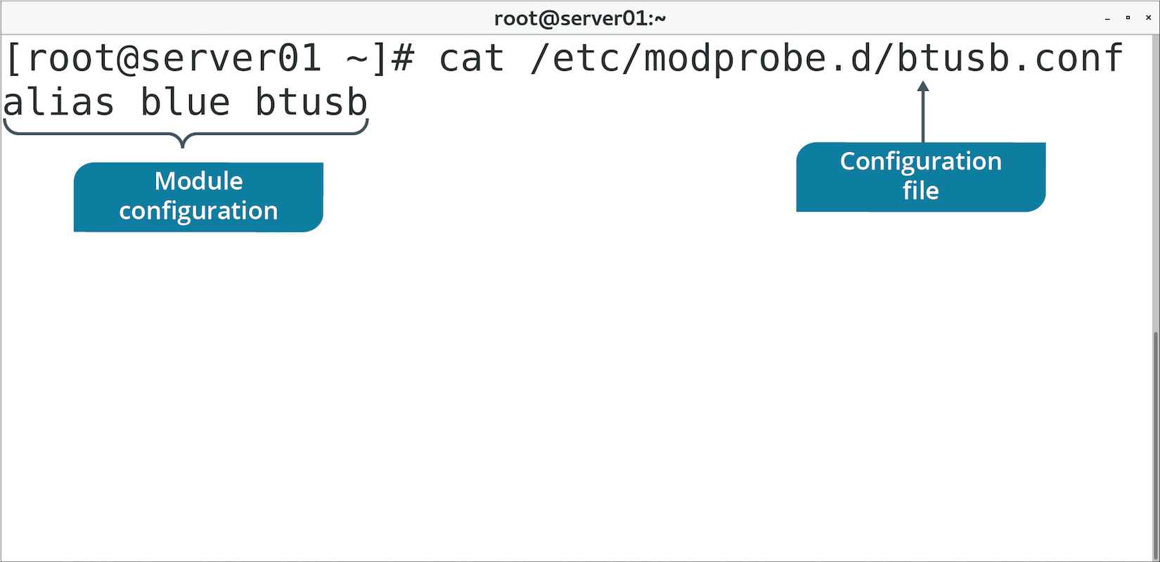
Kernel Module Configuration (Slide 2 of 2)

Slide 28
Kernel Parameters
You can change system parameters at runtime.
Improve performance, harden security, limit networking, etc.
/proc/sys/ lists configurable parameters.
Directory | Includes Parameters Related To
crypto | Cryptographic services.
debug | Debugging kernel.
dev | Hardware devices.
fs | File system data.
kernel | Miscellaneous kernel functionality.
net | Networking functionality.
user | User space limitations.
vm | Virtual memory management.
Notes:
Teaching Tip: Consider pointing out that vm parameters are some of the most commonly modified parameters.

Slide 29
The sysctl Command (Slide 1 of 2)
Used to view or set kernel parameters at runtime.
Option | Used To
-a | Display all parameters and their values.
-w {parameter}={value} | Set a parameter value.
-p[file name] | Load settings from specified file.
-e | Ignore errors about unknown keys.
-r {pattern} | Apply command to parameters matching a pattern.

Slide 30
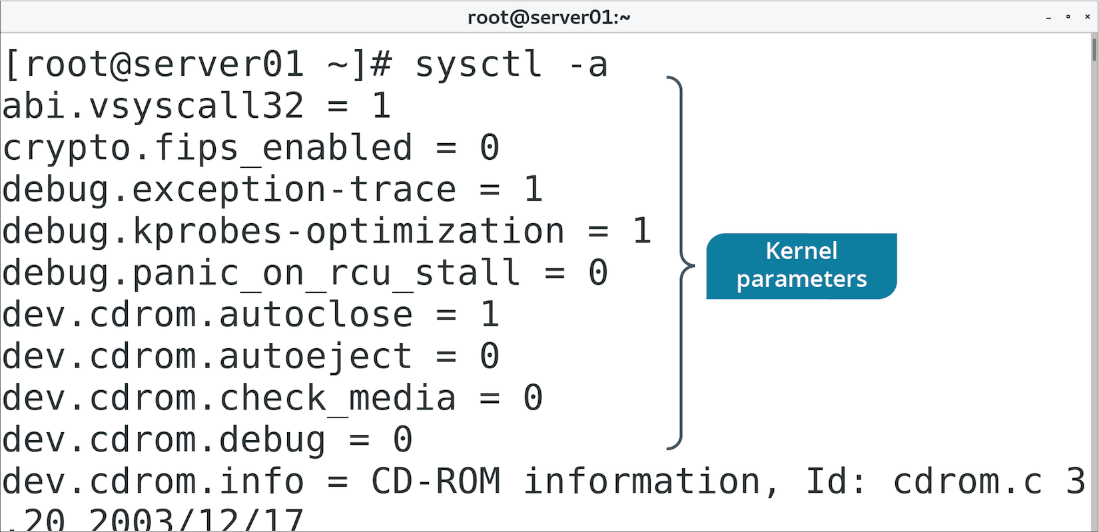
The sysctl Command (Slide 2 of 2)

Slide 31
Discussing Installing and Configuring Kernel Modules

Slide 32
Activity 6-3: Discussing Installing and Configuring Kernel Modules
You're sure that you compiled and loaded the kernel module for your new Ethernet card, but the card doesn't work. How can you check to be sure the kernel module is loaded?
ANSWER:
Use the lsmod command to list all currently loaded kernel modules.

Slide 33
Activity 6-3: Discussing Installing and Configuring Kernel Modules
You have downloaded a new kernel module that you want to load into your running system's kernel. You do so using the insmod command. You checked, and the kernel module is in the list of loaded modules, but it isn't working. What might have gone wrong?
ANSWER:
The insmod command loads only a specific module and does not load any dependent modules. It's likely that the module you loaded has a dependency.

Slide 34
Activity 6-3: Discussing Installing and Configuring Kernel Modules
You loaded a kernel module that has caused your system to become unstable. How do you remove the errant module?
ANSWER:
Use the rmmod command.

Slide 35
Activity 6-3: Discussing Installing and Configuring Kernel Modules
The developers at your company have created custom kernel modules to optimize in-house application performance. They supply you with all the necessary files to load the new modules, including dependent modules. When you load the first primary module using modprobe you receive multiple errors and the modules don't load because of broken dependencies. Which file or files can you examine to find the issues?
ANSWER:
The modules.dep file is the likely problem. This file identifies how modules and their dependencies are linked.

Slide 36
Activity 6-3: Discussing Installing and Configuring Kernel Modules
Your manager comes to you to discuss performing some no-cost security hardening on your Linux systems. Specifically, she asks you to protect the kernel from attacks. Which command and associated configuration file can you investigate to assist you in this task?
ANSWER:
The sysctl command and its configuration file, sysctl.conf, are used to tune and to set security parameters for a running kernel.

Slide 37
Activity: Installing and Configuring Kernel Modules
You want to transfer data to your mobile device wirelessly.
You plug in a USB Bluetooth adapter.
The adapter doesn't seem to work.
You discover the USB Bluetooth driver isn't available.
You'll inspect the kernel and load the appropriate module.
Notes:
Teaching Tip: Depending on the hardware the students are using, there is a chance that the Bluetooth driver will already be loaded by default. Students can still continue with this activity.

Slide 38
Topic C: Monitor Kernel Modules
Exam Objectives:
1.2 Given a scenario, install, configure, and monitor kernel modules.
2.7 Explain the use and operation of Linux devices.

Slide 39
The /proc/ Directory
File | Contains
/proc/cmdline | Options passed to kernel at boot time.
/proc/cpuinfo | CPU information.
/proc/devices | List of character and block devices loaded into kernel.
/proc/filesystems | List of supported file system types and any currently mounted.
/proc/meminfo | Information about RAM usage.
/proc/modules | Information about currently installed modules.
/proc/stat | Various stats about system since last reboot.

Slide 40
The /proc/version File (Slide 1 of 2)
Specifies info about kernel:
Version of kernel.
Version of GCC.
User name of compiler.
Time of compilation.
Version may impact system functionality.

Slide 41
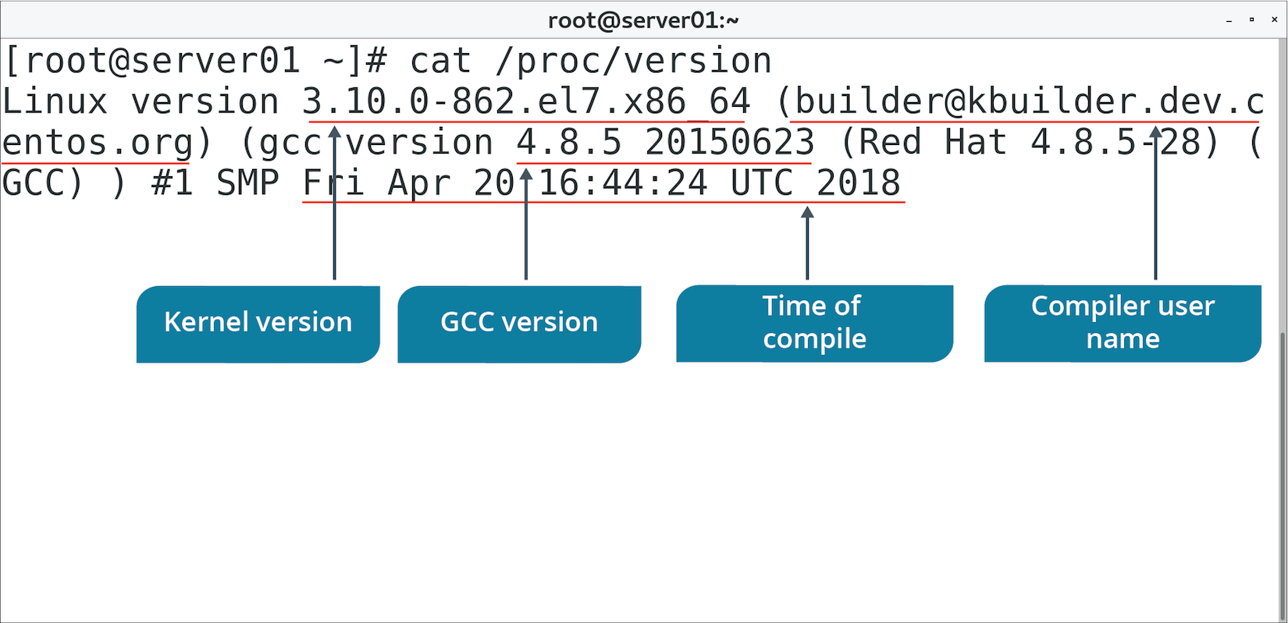
The /proc/version File (Slide 2 of 2)

Slide 42
The dmesg Command (Slide 1 of 2)
Prints messages sent to kernel buffer during and after boot.
Device drivers send messages.
Indicates status of modules/parameters.
Diagnostic messages when there are errors.
Other kernel components can send messages too.
Message buffer can also be accessed from /var/log/dmesg
Use to look for potential issues with kernel components.
Use to validate modules are loading.
Notes:
Teaching Tip: Consider pointing out that the dmesg command is also commonly used to troubleshoot a variety of system issues.

Slide 43
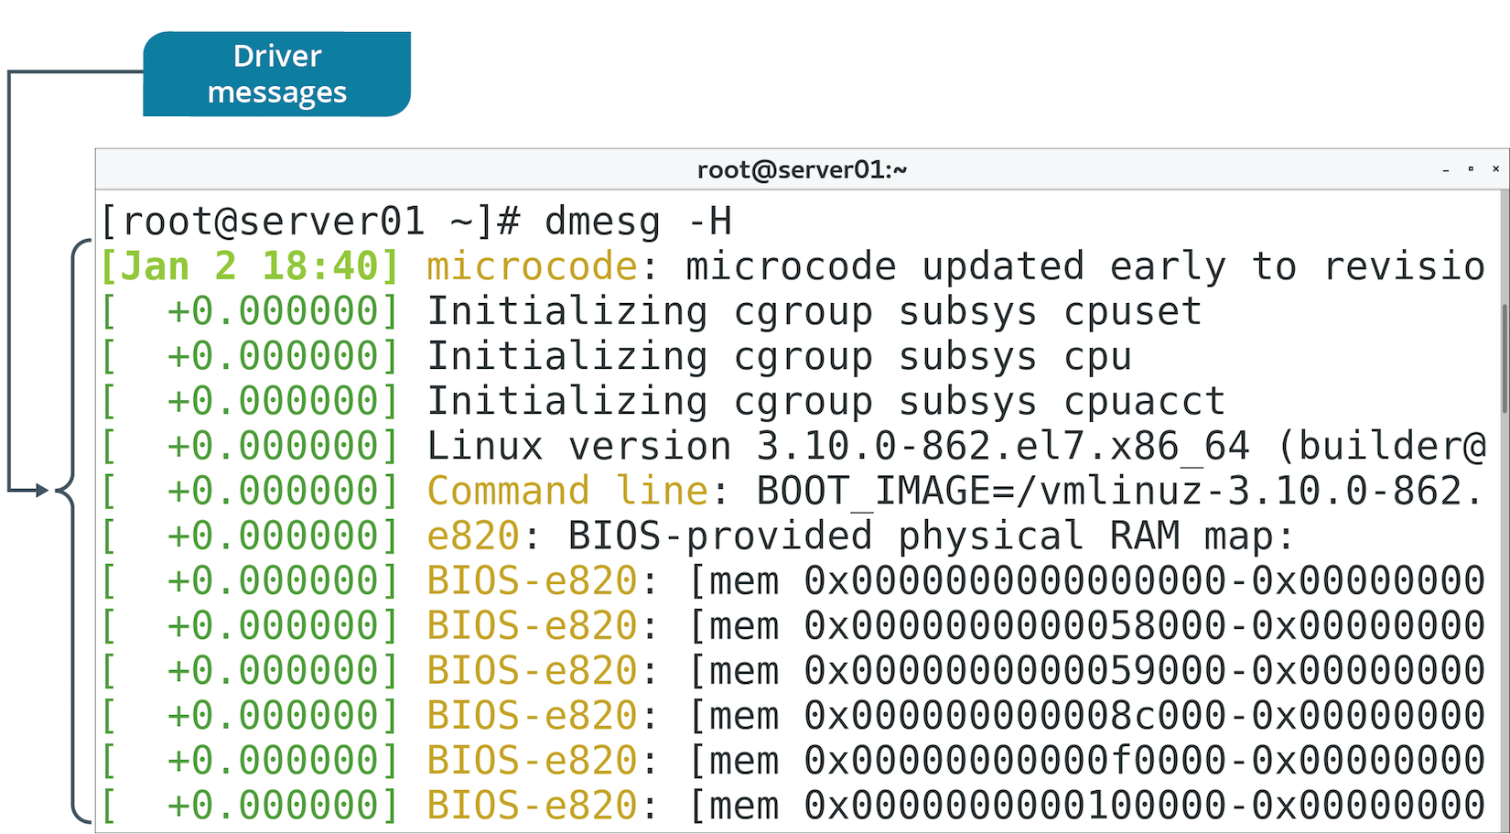
The dmesg Command (Slide 2 of 2)

Slide 44
Discussing Monitoring Kernel Modules

Slide 45
Activity 6-5: Discussing Monitoring Kernel Modules
You're a new system administrator and you might not know all the commands to find out every detail about a Linux system. Although you don't know the commands, where can you go on the file system to find out the same information in text file format?
ANSWER:
The /proc file system contains text files that hold process information, hardware information, kernel parameters, modules, and much more.

Slide 46
Activity 6-5: Discussing Monitoring Kernel Modules
A junior system administrator asks for your help in determining which components make up the Linux server he's working on. He needs to know brands, models, and other details of certain components to buy replacement parts. To which command or file(s) can you direct him?
ANSWER:
He should run the dmesg command to see a complete list of all attached hardware components and their details. Optionally, he can look at the /var/log/dmesg file.

Slide 47
Activity 6-5: Discussing Monitoring Kernel Modules
You believe that the network interface card is failing on one of your servers and you need to get the specifics of it so that you can replace it with the same product. Without going to the data center and opening the server's case, how can you find the network card's details?
ANSWER:
dmesg | grep –i network

Slide 48
Activity 6-5: Discussing Monitoring Kernel Modules
Your Linux web server seems to have a memory problem that you can't pinpoint through checking web logs or system logs. Where can you look to find details about system memory usage?
ANSWER:
The /proc/meminfo file contains all the system's memory information.

Slide 49
Activity 6-5: Discussing Monitoring Kernel Modules
You need to know which file systems are supported by one of your Linux systems. How can you find out?
ANSWER:
Look at the /proc/filesystems file to see a list of supported file systems.

Slide 50
Activity: Monitoring Kernel Modules
You want to ensure USB Bluetooth module was loaded into kernel.
You want to ensure there aren't any errors.
Also identify kernel version for future reference.

Slide 51
Do you expect that you will need to load any special modules into the kernel to fulfill your organization's requirements? If so, what modules might you need to load?
Do you expect that you will need to configure any kernel parameters at runtime? If so, what kind of parameters might you configure?

